Slide 1
THE SIMPLE INTEREST CALCULATOR WEBSITE
By,
NAME : MOHAMMED IRBAZ S
DEPARTMENT : BCA
COLLEGE : 366 - MERIT HAJI ISMAIL SAHIB ART & SCIENCE COLLEGE

Slide 2

iNTRODUCTION To MY Self
NAME : MOHAMMED IRBAZ S
CLASS : IIⁿᵈ YEAR BCA
COLLEGE : MERIT HAJI ISMAIL SAHIB ART & SCIENCE COLLEGE
SUBJECT : NM ( WEB DEVELOPMENT COURSE)
PROJECT : MY SIMPLE INTEREST CALCULATOR WEBSITE

Slide 3

WHAT IS simple interest calculator WEBSITE
presenting a curated collection of your best projects, clearly outlining your skills and qualifications, providing a comprehensive about me section, making it easy to contact you, and ensuring an intuitive, user-friendly design.
It is a unique way to showcase your work and let others know about yourself.

Slide 4

How I Started my project
Firstly, Making the Structure of the Calculator like text, input box, tag, etc.
Create using HTML tags and elements.
HTML is like a skeleton of a human.
Where it is not looks good without CSS.
Next, CSS is like the Muscle of the human to move flexible and looks shape perfect.
Then Javascript is the working Instruction how the body react for some operations.

Slide 5

Problem STATEMENT
In today's digital era, traditional paper and pen are not enough to calculate by humans, it will take any error, but A computer not a piece of mistakes.
Many students and professionals lack a structured online presence to highlight their work.
A digital Interest Calculator website provides an interactive and accessible
platform to present Accurate Solutions.

Slide 6

PROJECT OVERVIEW
In my Simple Interest Calculator Looks, Attractive and Responsive.
Added style as Professional looks and Attract the User on my Interest Calculator to Get Exact Solutions.
Smooth Scrolling Effect using JS and Pop-up Solution Page also added.

Slide 7

WHO ARE THE USER TO VISIT TO ACHIEVE AND GET BENEFITS FROM MY WEBSITE
STUDENTS : Thinking Some Idea from my Interest Calculator, to motivate from it to develop like this, etc…
JOB SEEKERs : To Share Ideas between others with recruiters.
Freelancers : To show to the clients to agree the projects and make it hopeful job.
PROFESSIONALS : To highlight experience and achievements, skills or knowledge about it.

Slide 8

TOOLS & TECHNIQUES
HTML : Structure ( Pages, Sections).
CSS : Styling (Colors, Layouts, Responsiveness).
JAVASCRIPT : Interactivity (animations, form validation).
Mention code editor : (VS Code) or CODEPEN and hosting platform (GitHub Pages).

Slide 9

Calculator design and layout
INCLUDED:
Principal Amount (₹)
Annual Interest Rate (%)
Time Period (Years)
Simple Interest = (P × R × T) / 100

Slide 10

FEATURES AND FUNCTIONALITY
Gradient Background Colour.
Project showcase with Input/Output.
Interactive elements (Form valuation, animations).
Calculator form (with validation).
Responsive design for all devices.

Slide 11
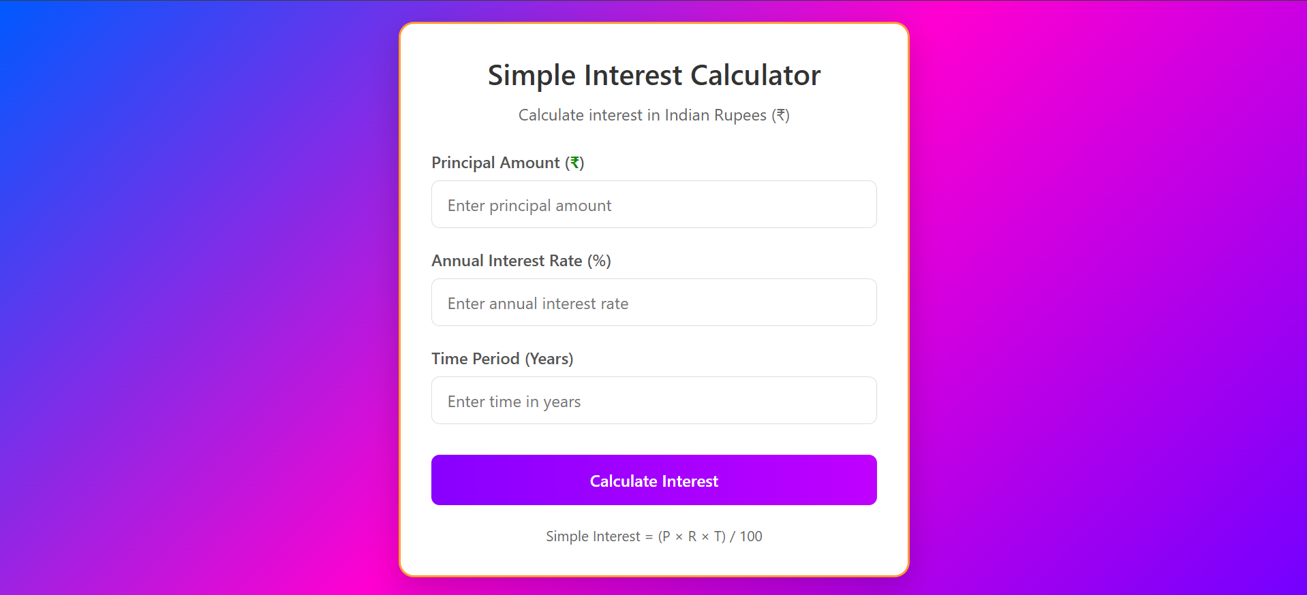
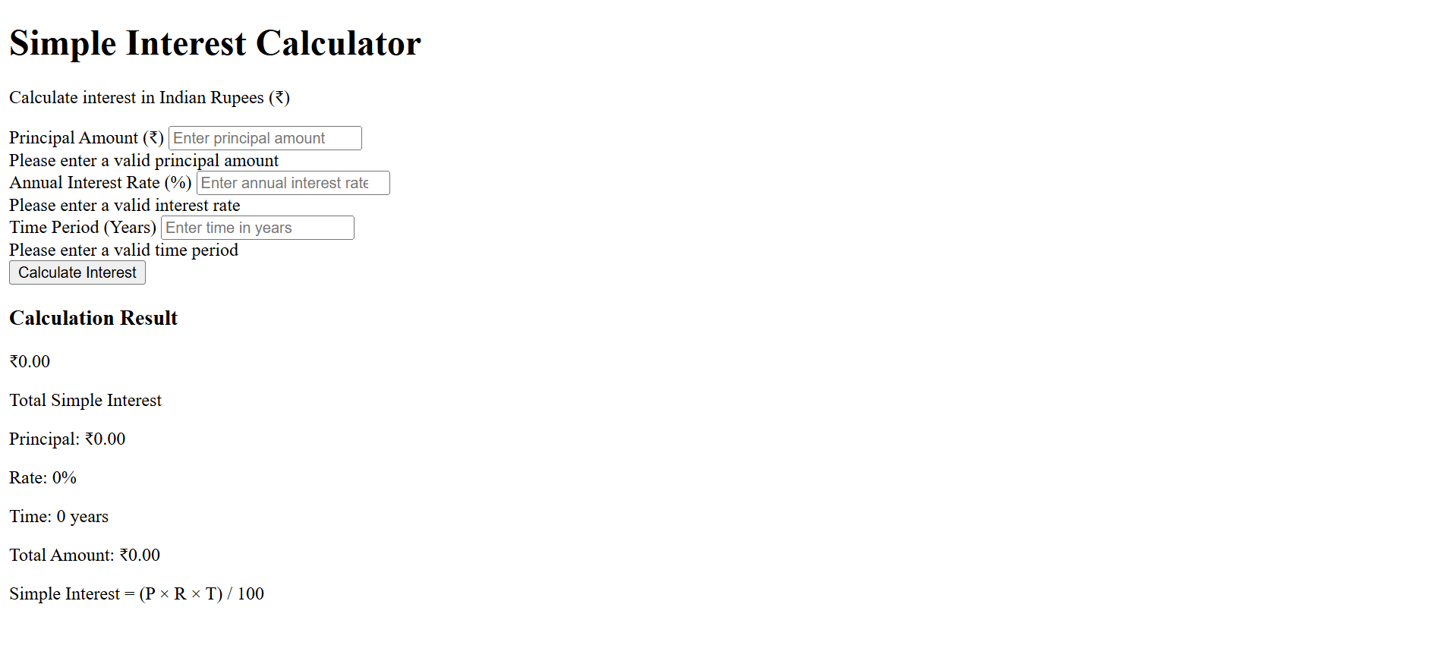
Results and SCREENSHOTS AFter
Screenshots of Each Section
Before and After (Plain HTML → With CSS & JS). BEFORE

Slide 12

Conclusion
My Interest Calculator websites it looks professional and Unique From Others because , it was made by full Effort and Times.
I request to all, visit my Simple Interest Calculator website and rank it, how is that.
It is mostly useful for students who are wants to make Interest Calculator look alike unique and professional completely.
Thankyou For All !

